Slide 1
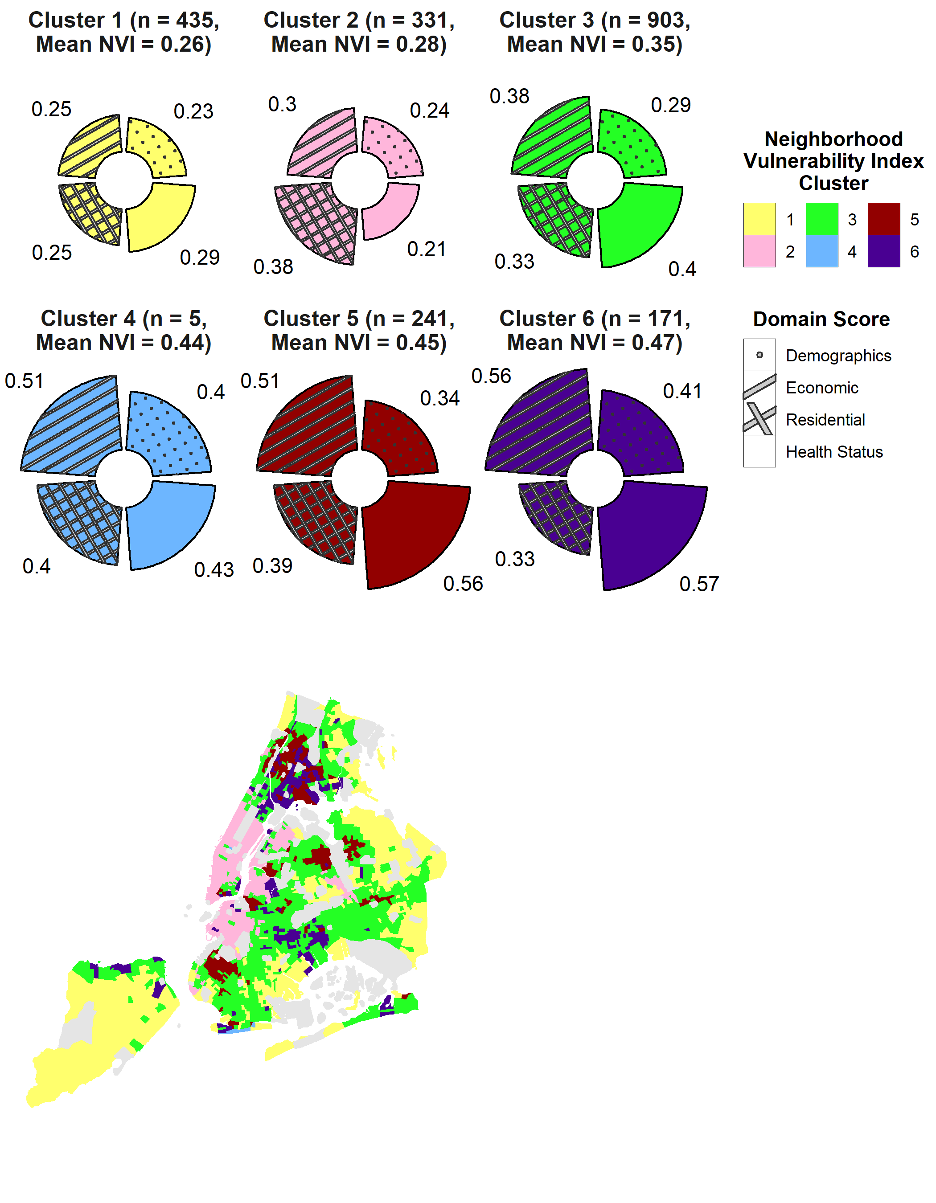
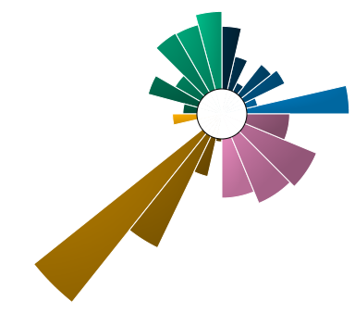
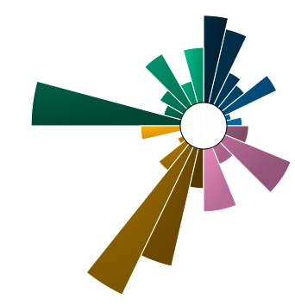
Census Tract 671
Queens County
(NVI = 0.239,
in Cluster 1)
Vulnerability Domain
Demographics
Economic Indicators
Residential characteristics
Health status
Census Tract 519
Kings County
(NVI = 0.239,
in Cluster 2)

